Slide 1
PRESENTATION ON CAR PRICE PREDICTION
Presented By
Dipesh Ramesh Limaje

Slide 2
Problem Statement
With the covid 19 impact on the market, we have seen a lot of changes in the car market. Now some cars are in demand hence making them costly and some are not in demand hence cheaper. One of our clients works with small traders, who sell used cars. With the change in the market due to covid 19 impact, our client is facing problems with their previous car price valuation machine learning models. So, they are looking for new machine-learning models from new data. We have to make a car price valuation model.

Slide 3
EDA Steps
1) Check data shape(Num. of Rows, Num. of Columns)
(4466,9)
So there are 4466 Rows and 9 Columns after treating duplicates and dropping null values.
2) Check each data type of columns and missing Values
So from data.info, we get all the information related to data types, and after observing all data types they are all ok.
3) Change the data types
After all observations, the data looks good we don't need to change any of the data types.

Slide 4
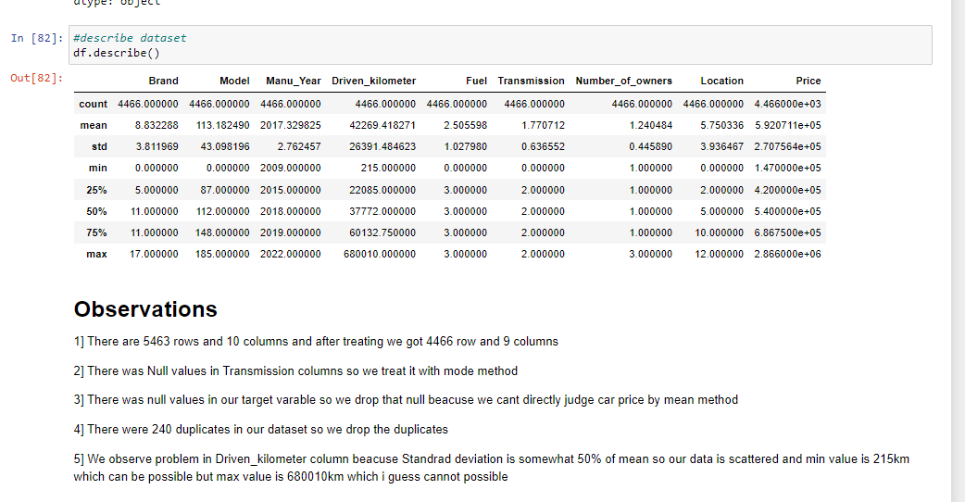
4) Summary Statistics
From this, we can see the data distribution that you have for each and determine whether there are outliers or not.
5) Check Duplicate values
In the dataset there are 240 duplicates and we directly dropped the duplicates.

Slide 5
6) See the data distribution and data anomaly
From the above bar graph, we observe there are 18 brands in our dataset and Maruti has the highest number of car in our dataset which is 1964 cars followed by Hyundai with 1106 cars and Honda with 517 cars.
From the above bar graph, we observe the Most listed cars which are the Grand i10 with 280 cars followed by WagnoR with 246 cars, and followed by Swift with 238 cars listed on the Cars24 site.

Slide 6
From the above bar graph, we observe the manufacturing year of the cars the most car listed in cars24 is of the 2019 year with 681 cars followed by the 2018 year with 599 cars, followed by 2017 with 556 cars.
From the above bar graph we observe Fuel of the cars and cars listed in car24 is mostly having fuel type petrol with 3552 cars followed by Diesel cars with 464 cars, followed by CNG cars and Hybrid cars with 401 and 1 car.
From the above bar graph we observe Manual Cars are listed more than automatic cars and count of the manual car is 3956 cars and the count of the automatic car is 510.

Slide 7
From the above bar graph, we observe 3428 cars is having 1st owners where 1002 cars have 2nd owners and 36 cars are having 3rd owners cars.
From the above bar graph, we observe there are 13 different locations, and all cars are listed from these locations and mostly cars are listed from Delhi with 500 cars followed by Bangalore, Noida, Ghaziabad with 480 car.
The bar graph is an illustration that shows the comparison of prices among different car brands. The information depicted in the bar graph indicates that the brands Jeep, MG, Maruti, and Audi have a relatively higher price compared to the rest of the car brands.

Slide 8
The bar graph provides information and comparison of prices among various cars based on their age. The bar graph reveals that cars which are older tend to have lower prices in comparison to the newest cars available in the market. This implies that the newest car models tend to have higher prices compared to the older models.
The bar graph presents information about the comparison of prices among different types of fuel-powered cars, including hybrid, diesel, petrol, and CNG cars. As indicated by the bar graph, hybrid cars tend to have the highest price, followed by diesel cars, and then by petrol and CNG cars, which have relatively lower prices compared to diesel and hybrid cars.

Slide 9
The bar graph provides a comparison of prices among cars based on their transmission type, which can either be automatic or manual. The bar graph shows that cars with automatic transmission tend to have a higher price compared to those with manual transmission. This suggests that the type of transmission a car has can greatly impact its overall price.
The bar graph presents a comparison of prices among cars based on the number of owners they have had. The bar graph indicates that cars with one owner tend to have a higher price compared to those with multiple owners. Furthermore, as the number of owners increases, the price of the car tends to decrease, suggesting that the number of owners a car has had can impact its overall price.

Slide 10
The bar graph provides a comparison of prices among cars based on the location where they are listed for sale. The bar graph shows that cars listed in Bangalore, Noida, Ghaziabad, Lucknow, and Delhi tend to have higher prices compared to cars listed in other locations. This suggests that the location where a car is listed for sale can have a significant impact on its overall price.

Slide 11
The Set Of Assumptions Related To The Problem Under Consideration
1] For this particular problem I have dropped the duplicate value which I have found.
2] For this particular problem I have assumed that the Maximum VIF should be 5, if any of the features has a VIF which is greater than 5 we should drop that feature.
3] I have directly drop the null values that are present in our target variable.

Slide 12
Steps
1) First we look for null values and we treat all null that are present in dataset.
2) Then I identified duplicates and I have dropped duplicates
3) Then we Performed EDA and wrote all observations for each graph
4) Then I dropped unnecessary columns
5) Then applied a label encoder to the categorical columns
6) Then also plotted the Distribution plot and regression plot
7) Then plotted boxplot to remove outliers
8) Then treated outliers with the Z-score method
9) Then scaled data and Also check for VIF
10) Then find the co-relation between feature and label by the CORR method.
11) Then we selected all the features because VIF was lesser than 5.
12) Then I created 4 models that are Gradient Boosting Regressor, Random Forest Regressor, linear Regressor model, and Ada Boosting regressor model with hyperparameter tuning for all 4 models.
13)At last I selected the best model according to their Hyperparameter score and Training(R2) and testing score(R2)

Slide 13
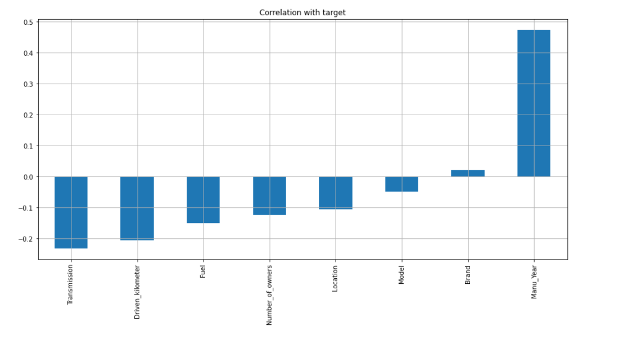
These are all the features that are positively co-related to the label and Negatively Co-related to the Label

Slide 14
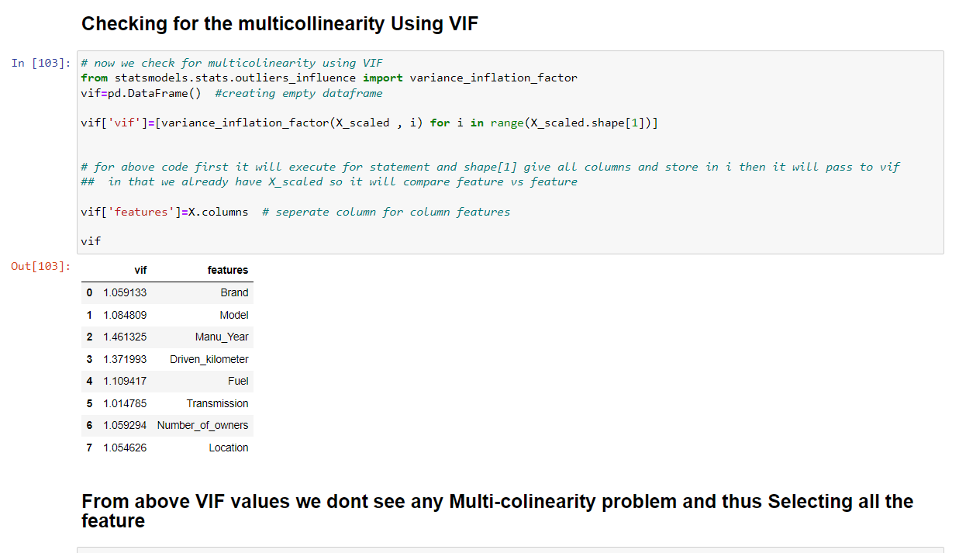
Selection Of top features which will help more to predict our label
All 8 features, including Brand, Model, Manufacturing Year, Driven Kilometer, Fuel, Transmission, Number of Owners, and Location, have been selected as the VIF is within the acceptable limit.

Slide 15
Testing of Identified Approaches (Algorithms)
LR (Linear Regression Model)
GBDT (Gradient Boosting Regressor Model)
RF (Random Forest Regressor Model)
ADA (AdaBoost Regressor Model)

Slide 16
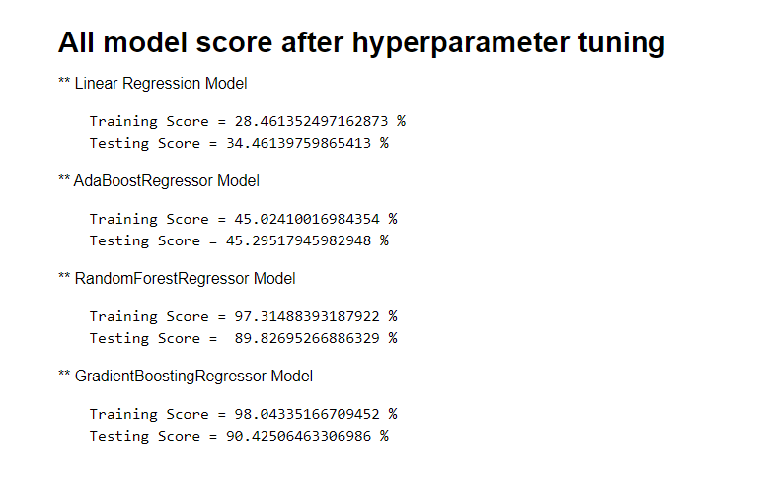
In the process of predicting car prices, we evaluated four different models and fine-tuned their hyperparameters to enhance their performance. After conducting this thorough analysis, we determined that the Gradient Boosting Regressor Model was the most suitable for our purpose. This model demonstrated the highest accuracy and effectiveness in our tests, and as a result, we have made the decision to proceed with using the Gradient Boosting Regressor Model for our car price predictions.

Slide 17
CONCLUSION
Based on the scores of the four models, it can be concluded that the Gradient Boosting Regressor Model is the best suited model for this particular task. The model has a training score of 98.04% and a testing score of 90.43%, making it an ideal choice and thus, it is saved for future use.

